Slide 1

Rescue Bot for Mine Exploration

Slide 2



Introduction
Background
Mines are hazardous environments, often subject to dangers such as gas leaks, sudden collapses, and difficult terrains. Search and rescue missions in mines pose significant risks to human life.
Objective
Develop a robot that can navigate these challenging environments and search for survivors in a safe and efficient manner.
Key Features
Autonomous Navigation: The bot uses path finding algorithms to navigate the mine grid avoiding obstacles.
Survivor Detection: The bot can detect survivors based on predefined markers or sensors.
Recharge Capability: The bot can recharge itself at designated stations.

Slide 3
Technical Overview
Environment Setup
Path finding Algorithm
The cave is modeled as a 2D grid. Each cell represents different elements:
State-Based Path finding
The robot's navigation uses state-based decision-making. Each state is a grid position with costs (distance,obstacles). A heuristic function minimizes energy and path length.
"." for empty space.
"D" for danger/obstacles(black).
"S" for survivors(green).
Multi-Target Finding
"R" for recharge stations(blue).
The grid is dynamically generated using cave_matrix.py, defining terrain and placing survivors and recharge stations.
The bot rescues multiple survivors. It locates the nearest survivor, rescues it, updates its state, and searches for the next. This continues until all survivors are rescued or unreachable, efficiently handling multiple goals while managing battery and time.

Slide 4
Key Features
Real-Time Navigation
The bot continuously adjusts its path based on the current state, considering factors like battery level and obstacles.
Battery Management
The bot monitors its battery and seeks recharge stations when necessary, ensuring continuous operation.
Multi-Target Rescue
Capable of rescuing several survivors, the bot optimizes pathfinding for each survivor while conserving battery.

Slide 5



System Architecture
Backend (algorithm.py & robot.py)
Core decision-making and pathfinding logic control bot behavior and path updates.
Interface (app.py)
Flask-based interface displays real-time updates on robot position, survivor status, and mission progress.
Visualization (tkintervisul.py)
provides a graphical representation of the robot's movements by creating a visual map of the robot's path on a grid.

Slide 6
Analysis of Performance
Algorithm Overview
Rescue Process
System Components
The multi_target_pathfinding algorithm efficiently navigates hazardous mine environments to rescue survivors.
Locate Nearest Survivor: A* search identifies the optimal path to the closest survivor.
2D Grid Model: The mine is represented as a 2D grid with cells indicating terrain features (empty space, hazards, survivors, recharge stations).
Navigate and Rescue: The bot navigates to the survivor, optimizing for efficiency and safety.
It integrates A* search for shortest paths to survivors and recharge stations, and incorporates battery management to ensure continuous operation.
Dynamic Grid Generation: cave_matrix.py generates the dynamic grid.
Battery Check: Continuous battery monitoring triggers a pathfinding search for the nearest recharge station if needed.
Data Structures: Efficient data structures (adjacency lists, priority queues) manage pathfinding and grid traversal.
Iterate: This process repeats until all survivors are rescued or unreachable.

Slide 7
Comparison with other algorithms
Feature
Conventional Algorithms (e.g., A*, Greedy, Dijkstra)
Our Algorithm
Target Handling
A* works well for one target, but requires recalculating paths for each new target. Greedy is quick but often inefficient. Dijkstra finds all shortest paths, but is slow.
Efficiently handles multiple survivors without repeated path calculations.
Battery Management
None
Tracks battery levels and prioritizes recharging when needed.
Real-Time Adaptation
Limited or no adaptation to real-time changes.
Adapts paths dynamically in response to obstacles or new conditions.
Resource Efficiency
Can be energy-intensive and may use longer paths.
Uses less energy and takes shorter, more efficient paths.
Mission Specificity
General-purpose algorithms not tailored for rescue.
Specifically designed for mine rescue missions.
Our algorithm is faster, smarter, and better suited for rescue tasks than conventional algorithms.

Slide 8
Constraints in the Rescue Robot System
Multi-Target Pathfinding: The robot efficiently handles multiple survivors, prioritizing the nearest and dynamically updating paths as needed.
Movement Validity: Navigation is restricted to valid grid positions, avoiding obstacles and out-of-bounds areas for safe operation.
Survivor Prioritization: The A* algorithm guides the robot to the nearest survivor first, adapting paths as survivors are rescued.
Pathfinding Optimization: The A* algorithm with Manhattan distance ensures the shortest, most efficient paths.
Visited Tracking: Visited positions are tracked to avoid redundant exploration, enhancing computational efficiency.
Resource Accessibility: Navigation dynamically adapts to available recharge stations and environmental constraints.
Key Takeaway: The system prioritizes survivor rescue by combining multi-target pathfinding, efficient resource management, and adaptive navigation, optimizing battery use and avoiding unnecessary travel.

Slide 9
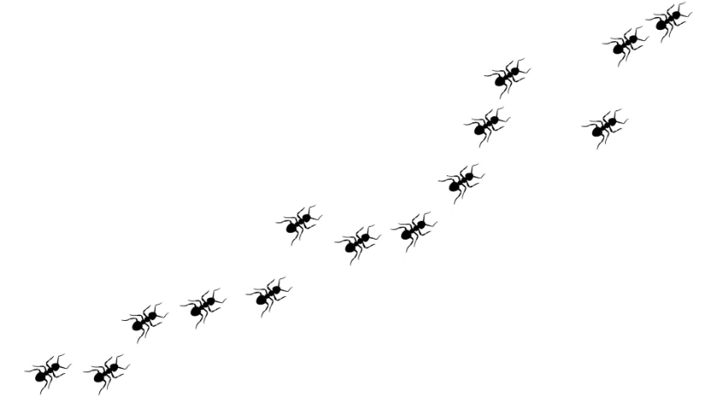
Ant Colony Optimization
Ant Colony Inspiration
ACO mimics how ant colonies find the shortest path to food using pheromone trails. Shorter paths get stronger trails, guiding more ants to the most efficient route.
The Algorithm
Ants initially explore randomly, depositing pheromones as they find paths. Shorter paths attract more ants, strengthening their trails. This process converges to the optimal solution, with pheromone evaporation preventing premature convergence.We also use brushfire algorithm.

Slide 10






Ant Colony Optimization Algorithm for Mine Rescue
Initialization:
Create heuristic grid (Potential Field Heuristic), initialize pheromone grid.
Ant Movement:
Each ant moves step-by-step, choosing next grid based on pheromone and heuristic influences.
Pheromone Update:
Ants deposit pheromones proportional to path length. Pheromone evaporates over time.
Path Optimization:
Geometric path optimization refines paths after initial exploration.
Iteration:
Repeat ant movement and pheromone update for multiple iterations.
Result:
The shortest path to all survivors is obtained.

Slide 11
PEAS Diagram for ACO
Performance Measure
Environment
Actuators
Sensors
A 2D grid of size 20x20.
Move to neighboring grid cells.
Detect neighboring cells to move to.
Find the shortest path from start to end.
Contains obstacles at fixed grid locations.
Update pheromone levels across grid cells.
Measure heuristic values (potential fields).
Avoid obstacles while traversing the grid.
Contains survivor fields with varying weights.
Reinforce pheromone trails on optimal paths.
Monitor pheromone levels in grid cells.
Include survivor field influence in path.
Defined start point and end point.
Recognize survivor field weights.
Minimize time taken and optimize resources (pheromone).
Identify grid boundaries and obstacles.

Slide 12
Why ACO is Better for Multi-Target Rescue
Path Optimization
Order of Visits
ACO efficiently finds the shortest or most efficient routes for multiple targets, saving distance and battery life.
ACO determines the optimal sequence for rescuing survivors and maximizing efficiency.
Scalability
Constraint Incorporation
ACO excels in large search spaces, handling numerous targets effectively by evaluating paths concurrently.
ACO directly integrates constraints like survivor, ensuring feasible and energy-efficient paths.

Slide 13
Rescue Bot Algorithm Flowchart
Start
1
2
Survivors List Empty?
Yes: End
3
4
No: Find Paths to All Remaining Survivors using A*
Are Any Survivors Reachable?
5
6
No: Recharge Stations Available?
Yes: Find Paths to All Recharge Stations using A*
7
8
Are Any Recharge Stations Reachable?
Yes: Select Shortest Path to Recharge Station
9
10
Update Current Position and Path
Battery = 100
11
12
Repeat from "Find Paths to All Remaining Survivors using A*"

Slide 14







program flow
1. Grid Generation
Generate Cave Grid, Add Obstacles, Add Survivors, Add Recharge Stations, Return Grid
2. A* Search
Initialize, loop while open_set not empty, check if current == Goal, calculate tentative cost, check for cheaper path, update costs and open_set, return path or empty list
3. Heuristic
Calculate Manhattan Distance, Return Distance
4. Multi-Target Pathfinding
Initialize, loop until all survivors rescued, generate paths using A*, filter paths, find shortest, update battery, handle battery low scenarios, return results.
5. RescueRobot Class
Initialize Robot, start rescue, find elements, use multi-target pathfinding, return path and rescued survivors
6. Grid Visualization
Create Grid, visualize path (animate robot)
7. Flask Web Application
Define routes, run Flask app

Slide 15
Cave Grid Generation
Empty Spaces (.)
Dangers (D)
Default state for most grid cells.
Randomly placed hazards. 15 positions chosen randomly, avoiding the starting point (0, 0).
Survivors (S)
Recharge Stations (R)
Placed randomly in 3 empty positions.
Randomly placed in 2 empty positions.
Code Overview
This Python function generates a 10x10 grid-based cave environment with the elements detailed above.

Slide 16
State Space Components
Robot Position
Survivors Remaining
Recharge Stations
Visited Grid
Battery Level
Path Taken

Slide 17
PEAS Diagram
Performance Measure
Environment
Actuators(in code grid movement)
Sensors(in code)
Grid with cells representing space.
Proximity sensors (to avoid obstacles and detect nearby objects).
Successfully rescue all survivors.
Motors to move the robot.
Fixed positions for survivors and recharge stations.
Minimize battery usage.
Gripper or mechanism to rescue survivors.
Battery sensor (to track remaining battery).
Minimize time spent.
Maximize the area covered.
Obstacles .
Recharge mechanism (for battery).
Position sensors (to track the robot's location).

Slide 18

Future Enhancements
We plan to enhance the Rescue Bot by incorporating more advanced path-finding algorithms like ant colony optimisation , to improve its efficiency and adaptability to dynamic environments.
We are also exploring advanced sensor technologies to improve target detection in low-visibility conditions.
Finally, we aim to develop a self-learning capability that allows the bot to improve its performance over time based on past missions.

Slide 19

Conclusion
The Rescue Bot for Mine Exploration offers a highly efficient and reliable solution for rescuing survivors in hazardous mine environments. Its innovative Multi-Target Pathfinding Algorithm optimizes rescue operations, handling multiple survivors while effectively managing battery life and recharge points. This system represents a significant advancement in mine exploration and rescue, providing a safer and more efficient approach to these critical operations.

